Slide 1
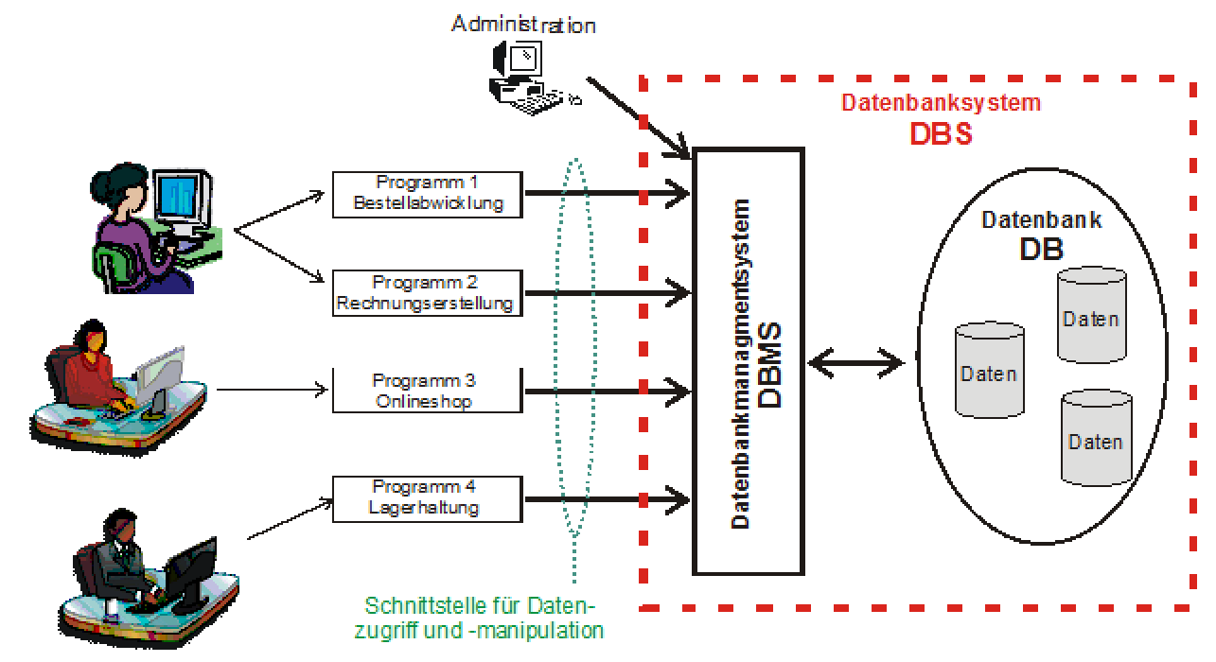
MySQL Workbench
phpMyAdmin
XAMPP
HeidiSQL
MySQL
S Q L
eGameDarling

